Slide 1
Optical Fibre networks 1/4 Optical Fibre : characteristics
30/09/2024
Paul JOLIVET

Slide 2
Optical Fibre Networks : Course general objective
Get a panorama of Optical Fibre and networks
Optical Fibre characteristics and advantages
Technologies around Optical Fibre
Other components of optical fibre networks
Understand How to design high rates optical fibre networks
Existing architecture of Optical Fibre networks (FTTH, FTTA, FTTO…)
Designing a network
Deployment constraints
Understand High rate networks trends to future

Slide 3
Optical Fibre Networks : Course organisation
Programme
Course : 4 sessions (3h each) on Sept 30, Oct 7 and Dec 2 & 16
Project : 2 sessions with support on Oct 14 & Nov 18
Project Defence : Jan 13
Exam (no information on the schedule)
Two type of session with me
Course
Application on a project
A teamwork with contributions from all members
Practical use of the knowledge share in the courses
Search work on the internet
Support from teacher
Defence in English with slideshow and share of the speech between team members

Slide 4
Optical Fibre Networks : Course 1/4 programme
1. Optical fibre physics and principles
The medium
Principle of communication using light
Types of fiber optics
2. Optical fibre Cables
Cable types, evolution, active systems
Cables with tubes, ribbons
3. Optical fibre accessories
Connectors and splicing optical fibre
Jumpers between equipments
Connecting with optical fibre
4. Installing optical fibre
Urban zones, other
Street cabinets, manholes and ducts
Aerial installation
Inter-continental cables, submarine

Slide 5
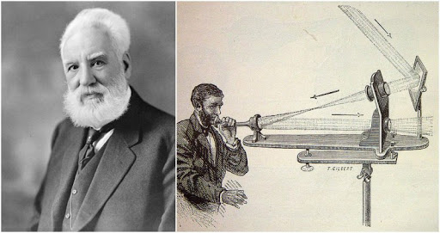
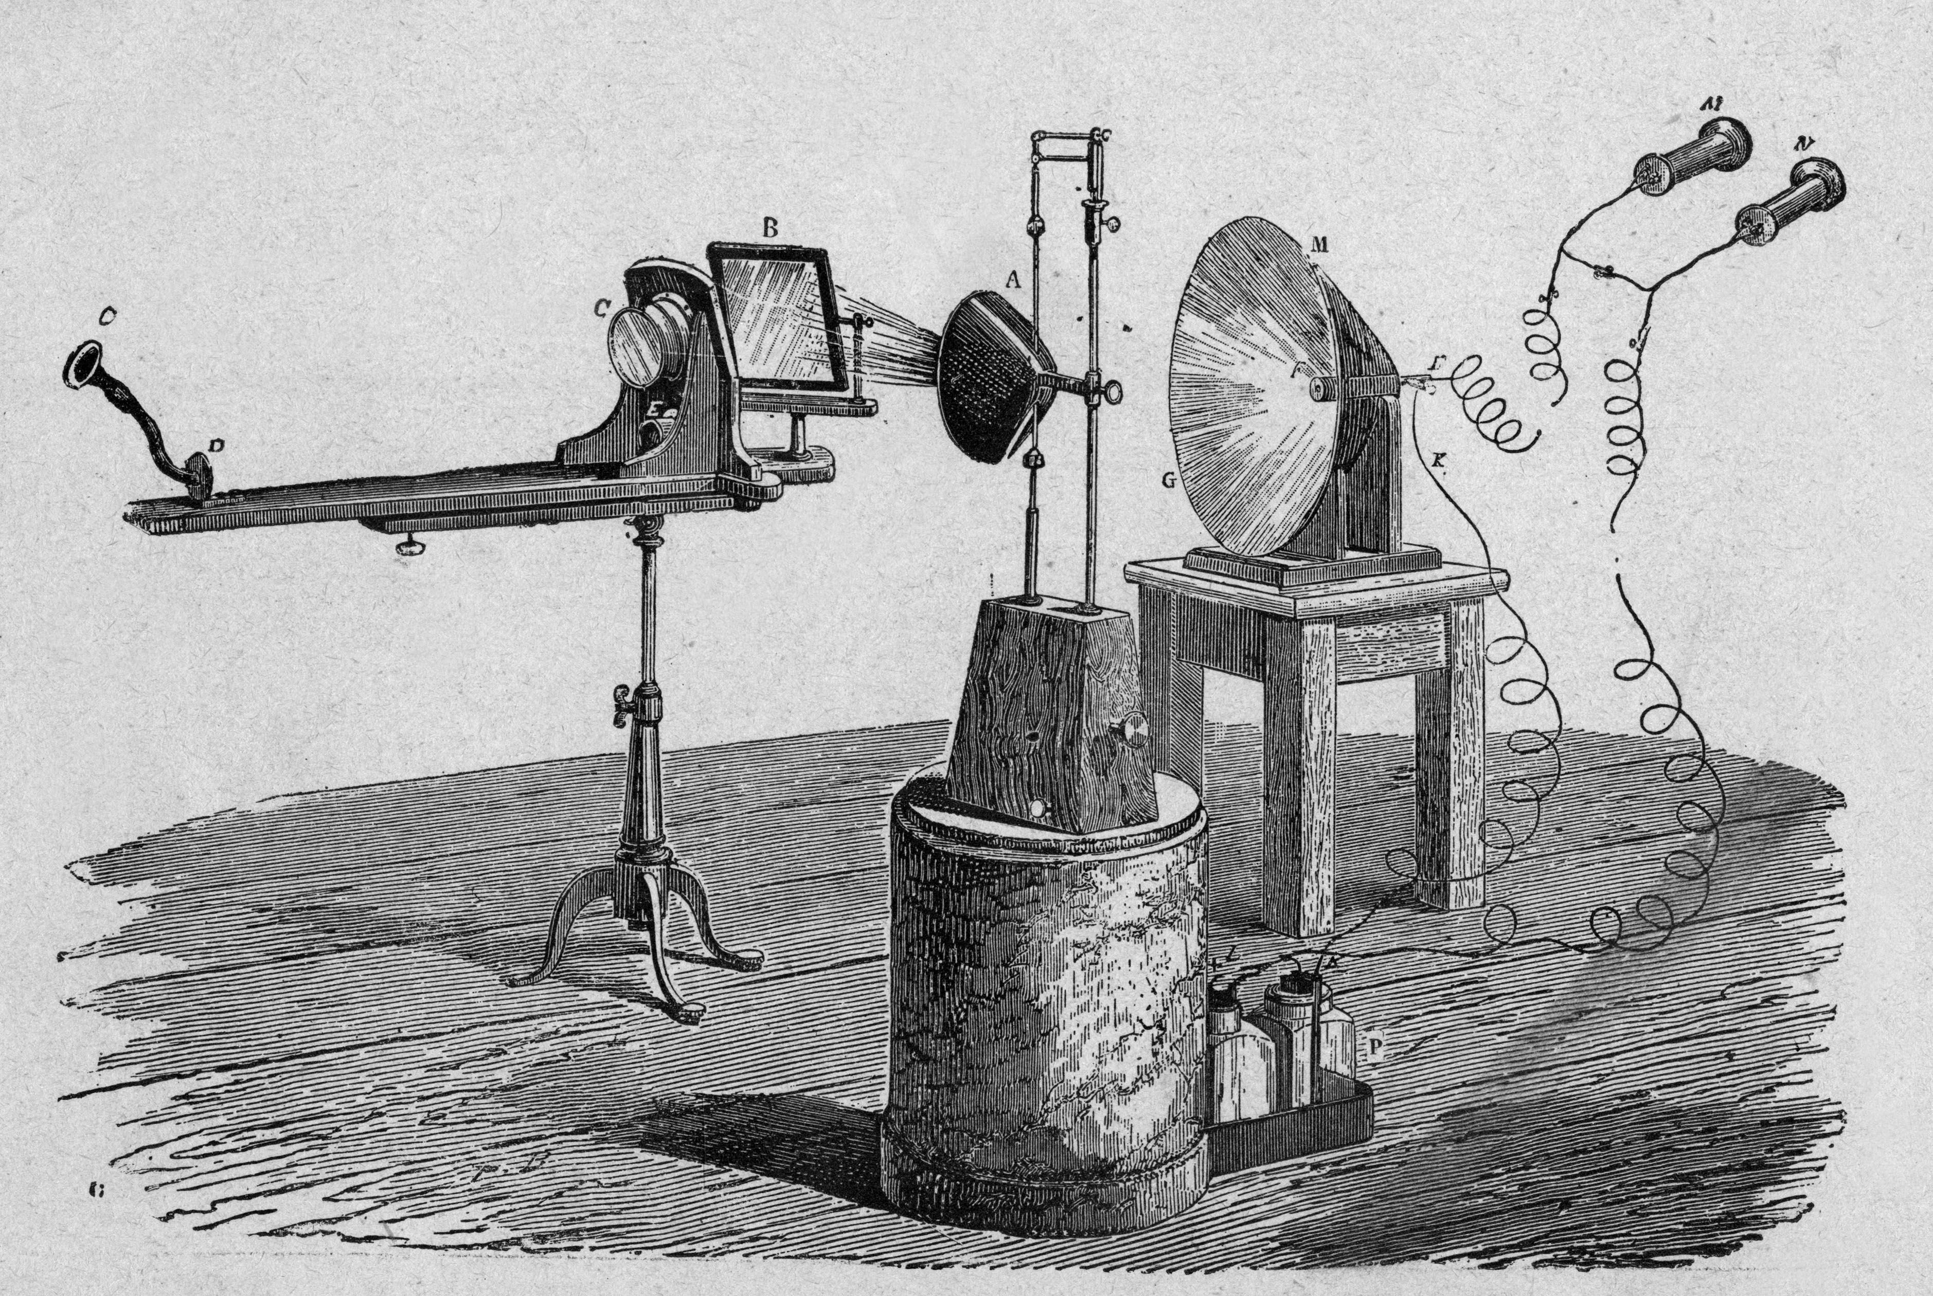
A bit of history
End of 19th century
Using mirrors to direct light
Conducting light in a water jet
Optical fibre created in the second half of 20th century
1961 Elias Snitzer and the theory for single mode fiber
1973 Bell Laboratories created the first fibre
1975 first telecommunication network on fibre optics
1980 Sprint uses the first full fibre optic network
1991 Desurvire et Payne demonstrate optic amplification, opening the field to long haul communication and internet
Source

Slide 6
Optical Fibre A bit of physics Medium characteristics

Slide 7
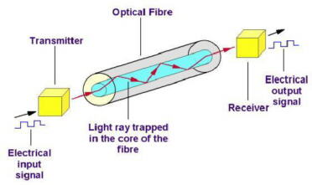
Optical Fibre, basic principles
light transmission
Transmission components
Coding the message into electric input
Transcoding the electric input into light signal
… and the reverse operation
Principle of a wave guide
Fibres are behaving like a guide for the signal
Optical physics applies, including
Reflections
Refraction
Attenuation due to the material
Optical Fibre and LASER are combined and optimise signal transmission

Slide 8
Electromagnetism and transmission
Electromagnetic spectrum
Large use of the electromagnetic spectrum for technology
Used spectrum for fiber optic
Using wavelength close to infrared … above visible light
Wavelength @ 0,85µm + 6 bands
(see table)
Wave length
1nm
1µm
1cm
1m
1km
Gamma
Rays
X Rays
Ultraviolet
Infrared
Hyper frequencies
Radio waves
Frequency
1EHz
1PHz
1THz
1GHz
1MHz
1kHz
Color | From… | …to
Red | 0,62 - | 0,70 µm
Orange | 0,59 - | 0,62 µm
Yellow | 0,57 - | 0,59 µm
Green | 0,50 - | 0,57 µm
Blue | 0,44 - | 0,50 µm
Violet | 0,40 - | 0,44 µm
 | From… | …to
O | 1,26 - | 1,36 µm
E | 1,36 - | 1,46 µm
S | 1,46 - | 1,53 µm
C | 1,53 - | 1,565 µm
L | 1,565 - | 1,625 µm
U | 1,625 - | 1,675 µm

Slide 9
Typically used wavelength
Range of wavelength for Optical Fibre
From 800nm to 1600nm (visible spectrum is from 400 to 700 nm)
Commonly used wavelength is
850 nm and 1300 nm for multi-mode fibres
1310 nm
1550 nm
Highly depends on the fibre index in one hand and the availability of laser on the other hand
These wavelength are optimising transmission properties of the fibre

Slide 10
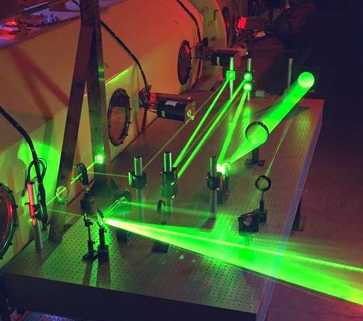
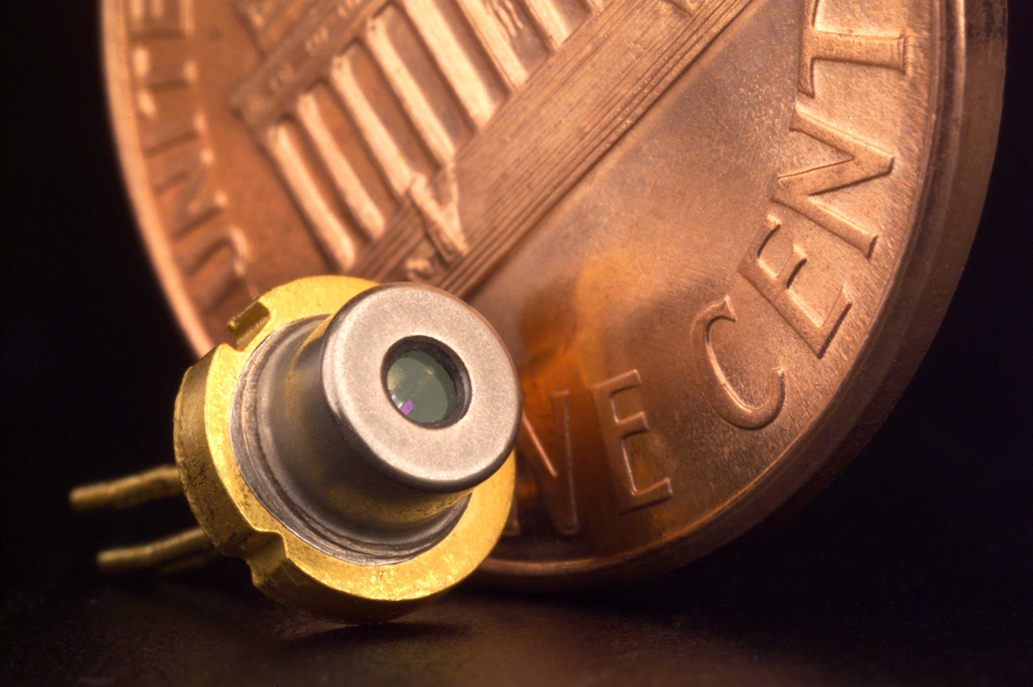
LASER technology
What is LASER?
Light
Amplification by
Stimulated
Emission of
Radiation
Principle and advantage
Coherent light
Constant wavelength
Spatial coherence that can be focused
Cutting application
Focused energy for long distance emission
Temporal coherence
Very narrow spectrum (single light color)
Possibility to emit ultrashort pulses

Slide 11
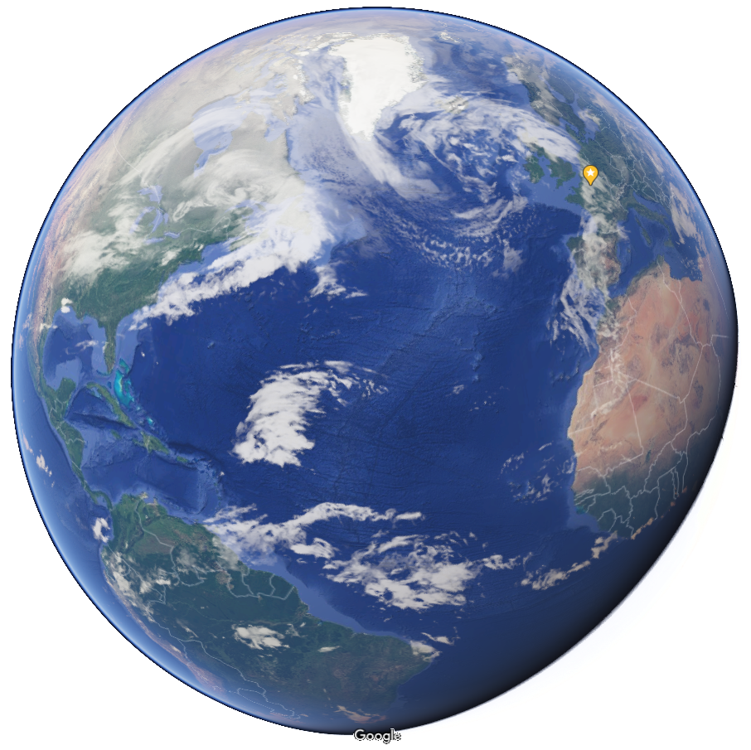
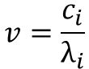

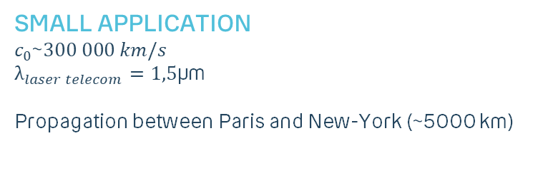
Using light for transmission : celerity
Wave physics… Basics about celerity
Wave characteristics in the fiber defined by its
$λ_{i}$ Wave length (m)
$v$ Frequency (Hz)
$c_{i}$ celerity (m/s)
$c_{0}=299 792 458 m/s$
$$v=\frac{c_{i}}{λ_{i}}$$
Medium characteristics
« i » defines the medium
Depending on its characteristics,
celerity and wavelength vary
Small Application
$$c_{0}\text{\sim }300 000 km/s$$
$λ_{laser telecom}=1,5\text{µ}$m
Propagation between Paris and New-York (~5000 km)
16,6 ms

Slide 12
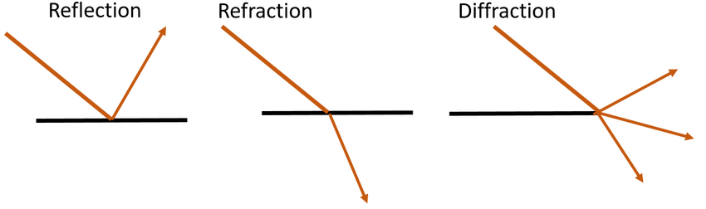
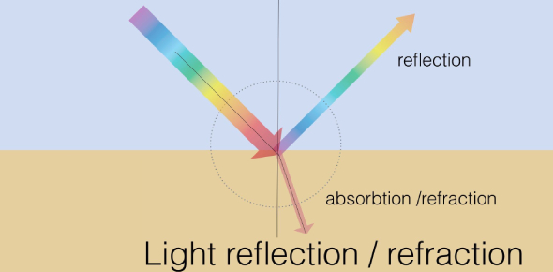
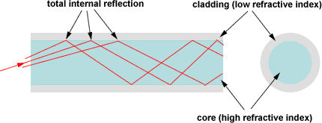
Using light for transmission : refraction
Refraction
Variation of direction of a wave propagating from one particular medium to another
Absorption
Transfer of energy while a wave propagated through a medium
Reflection
Brutal change of direction of a wave striking a surface
When do these phenomenon apply with optical fibre ?
Refraction
light entering in a fibre
Light moving from one fibre to another through a connector
Reflection
light reaching the border of the fibre while propagating
light striking mirror in splitter equipments

Slide 13
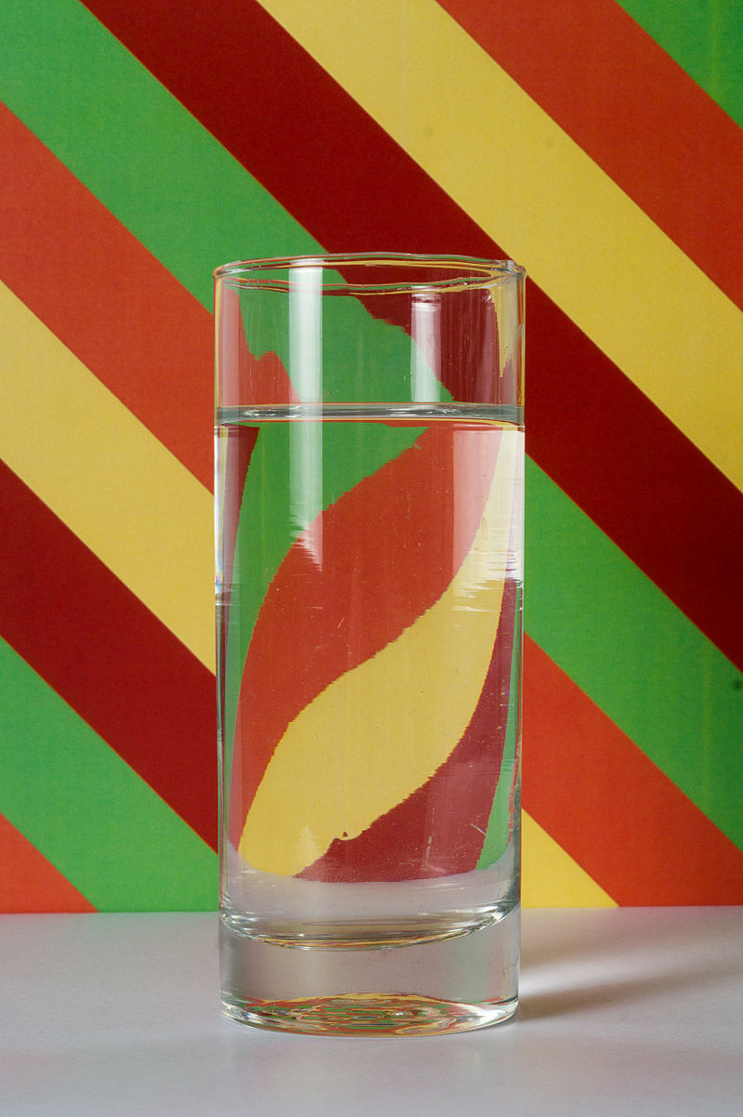
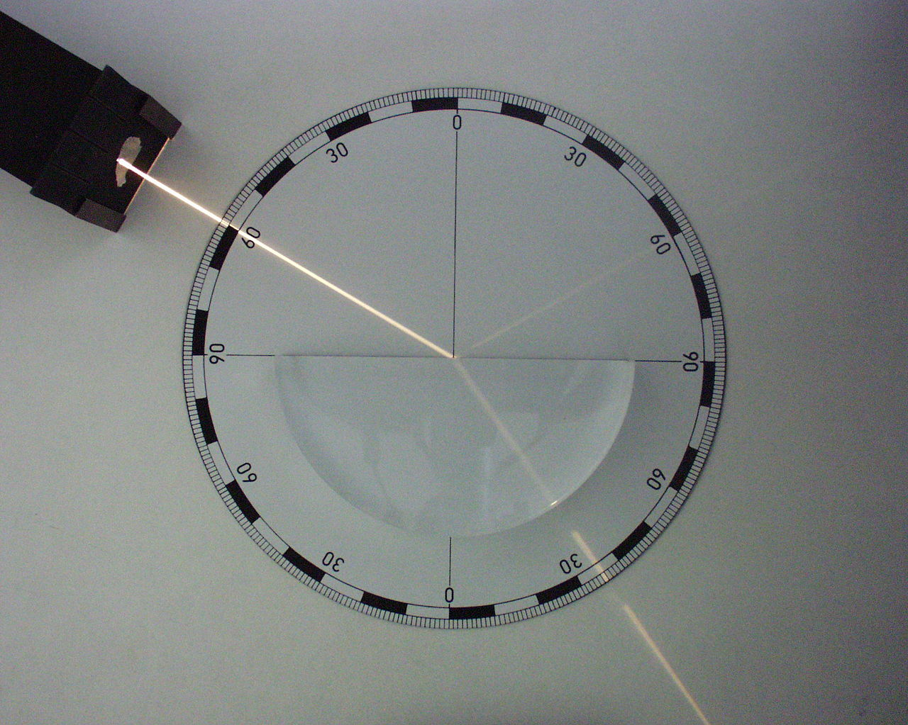
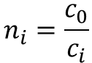
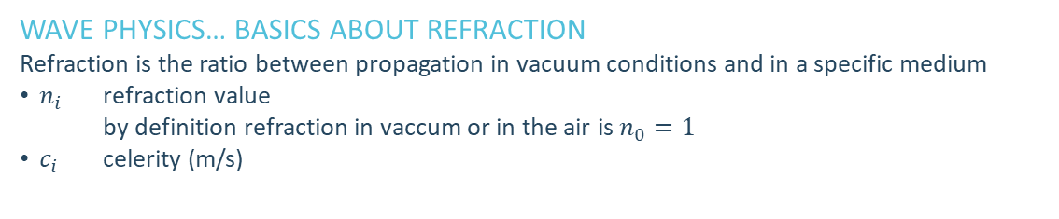
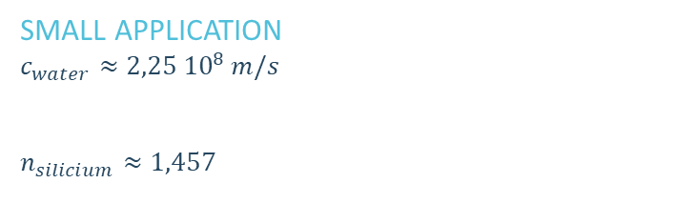
Using light for transmission : refraction
Wave physics… basics about refraction
Refraction is the ratio between propagation in vacuum conditions and in a specific medium
$n_{i}$ refraction value by definition refraction in vaccum or in the air is $n_{0}=1$
$c_{i}$ celerity (m/s)
$$n_{i}=\frac{c_{0}}{c_{i}}$$
Small Application
$$c_{water}≈2,25 {10}^{8} m/s$$
$n_{eau}=1,33$
$$n_{silicium}≈1,457$$
$c_{silice}=2 {10}^{5} km/s$

Slide 14
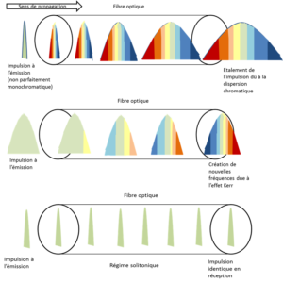
Fibre characteristics
Attenuation
Related to how the signal is getting weaker
Linear attenuation corresponds to reduction of signal power based on distance
Related to the wavelength (due to Rayleigh diffusion on the shorter waves)
Attenuation can be compensate by amplification systems
Chromatic Dispersion
Related to signal spreading : signal is getting larger as signal propagation celerity depends on wavelength
This effect can be compensated by fibre with index profile
Celerity
Approximately the same than for copper, i.e. 75% of light celerity
Can be even more in laboratories
Repeaters on long haul fibres are reducing average speed of the signal
Transmission rate
The highest rate communication was made by NEC @ 1Pbps (1M Gbps)
Paris – Noumea
20 000 km
theory 90 ms
in practise 280 ms
1 Pbps

Slide 15
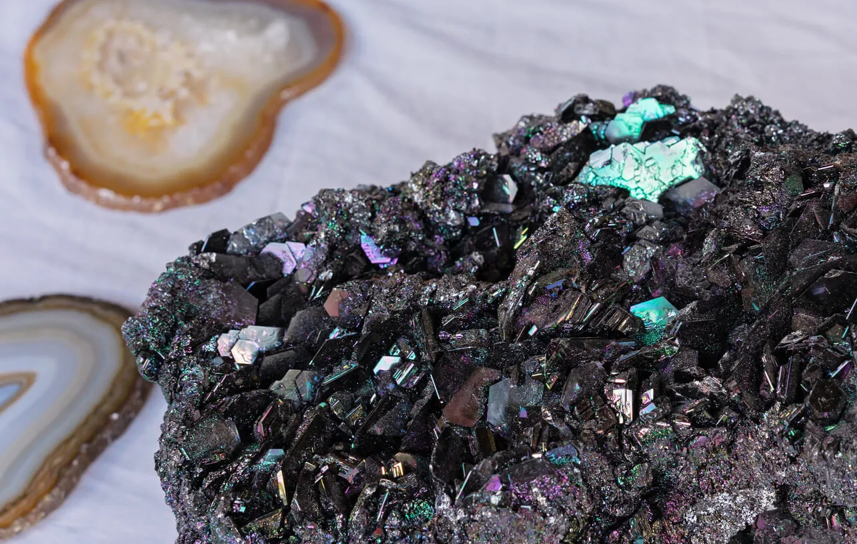
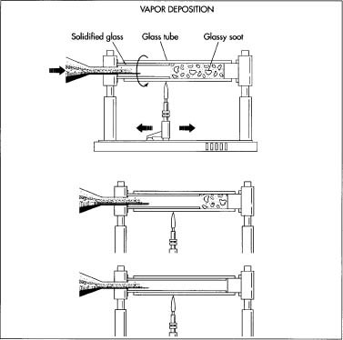
Creating optical fibre
MAterial
Silicium (SiO₂) is the most used material for optical fibre
Other raw material can be used depending on expected wavelength (longer in IR)
fluorozirconate, fluoroaluminate, and chalcogenide glasses
crystalline materials like sapphire
Manufacturing process
Silicium is melt from some piece in a vapored environment with various chemical vapors, including silicon tetrachloride (SiCl ₄ ), germanium tetrachloride (GeCl ₄ ), and phosphorous oxychloride (POC1 ₃ )
A cylinder of pure silicium is created (10cm long)
The cylinder is strechted to form the final core fibre.
This fibre is rounded by a coating made of a different silicium (with a different refraction index including for instance phosphore or germanium).
The fibre is finally polished to prevent incorrect reflections.

Slide 16
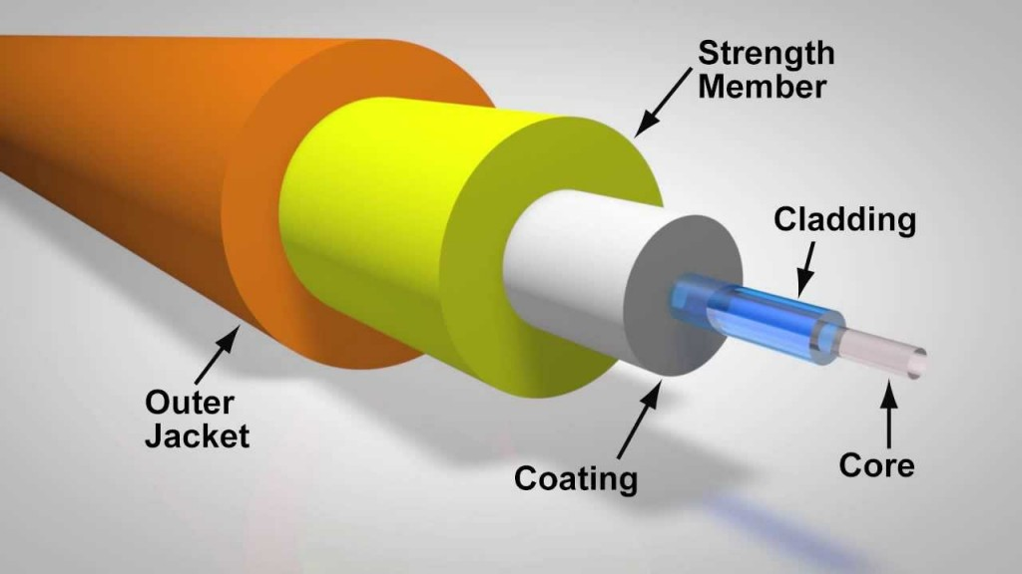
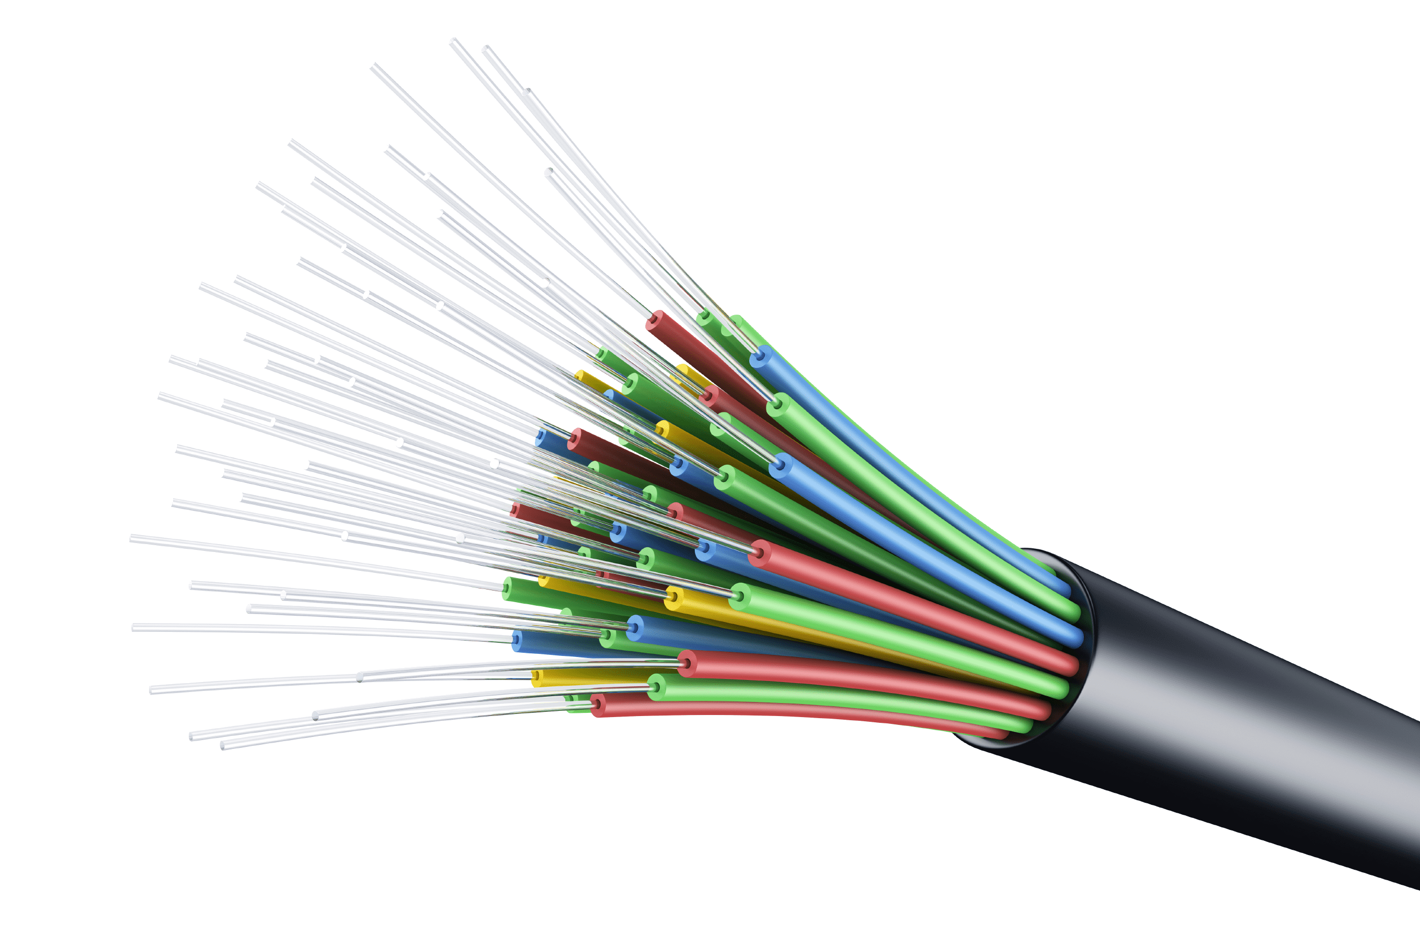
Optical fibre typical values
The fibre itself
Core : ~10 µm
Coating : ~100-150 µm
Cable
Typical number of fibres in a cable varies depending on the use
Few fibres for local use in an office or home
Dozen to few dozen of fibres for collecting trafic or submarine cables
Hundreed of fibres for backbone / agregation cables
… some cases of thousands of fibres for datacenter connection (quite often preference is given to multiplying cables rather than concentrating fibres on a single cable)
Typical cable section : from less than a mm to few cm
… with a strong impact on the capability to get into existing ducts in dense areas

Slide 17
Optical Fibre Different types of fibre / cables

Slide 18
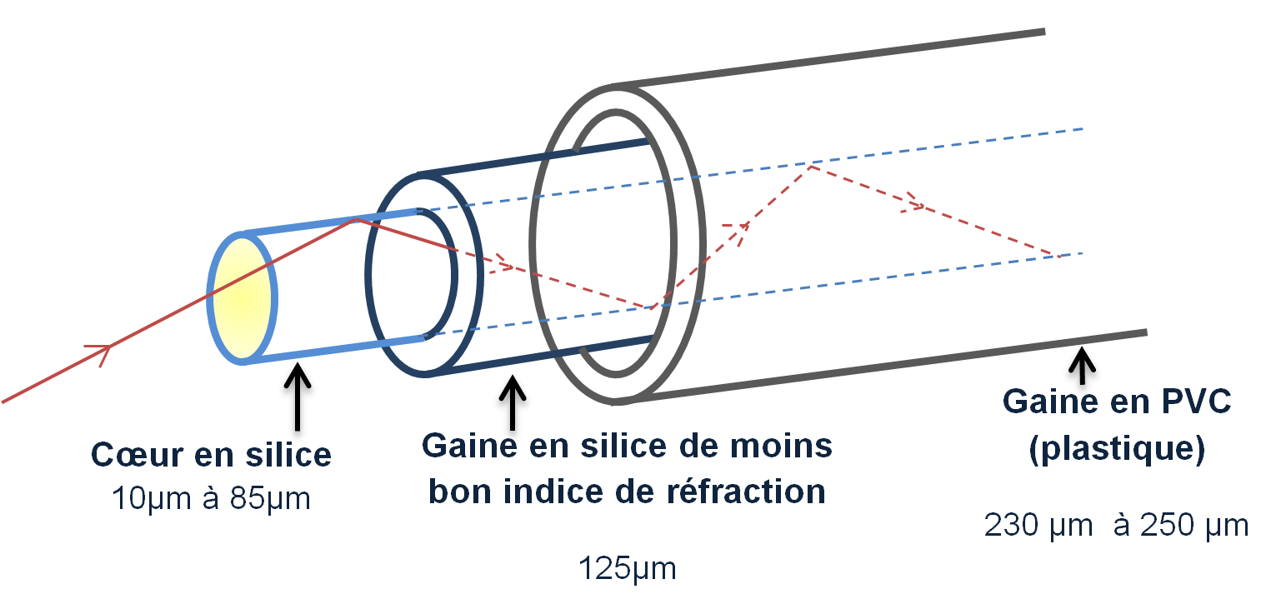
Application of refraction to optical fibre
Principle of wave propagation in Optical Fibre
Reflexion and refraction are used to guide the signal in the fiber.
The principle is:
To cancel any refracted ray
To maximise the reflexion and therefore to maximise the transmitted signal energy
To reach that objective, a fiber is made of multiple layers:
A core made of silicium with a fixed refraction index
A coating with a lower refraction index
A jacket to protect the fiber from the outside
The coating aims at containing the signal within the core of the fiber

Slide 19
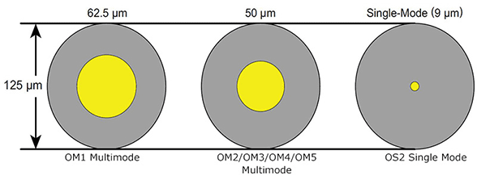
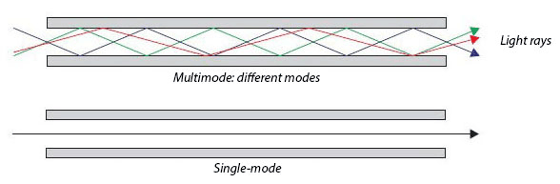
Optical fibre, technology evolution
Optical fibre: single/Monomode
Reduced size core allowing signal propagation straight
in the fibre
One only wavelength at a time, therefore no interference
Optimized for long haul and capacity
Optical fibre : Multimode
Multiple waves can coexist
Attenuation has to be managed over long distances
The other evolution to high rates : Multiplexing and Digital signal management
EDFA, WDM
Coherent detection
Digital Signal processing
Optical fibre in telecommunication is massively single mode fibre

Slide 20
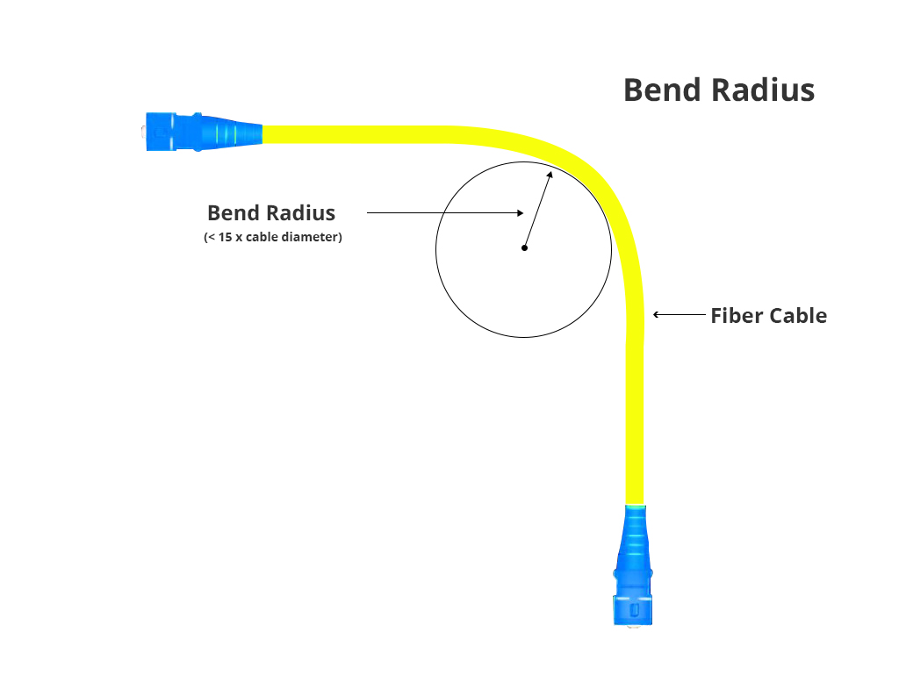
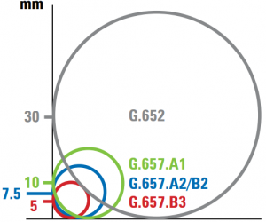
Limits of refraction for optical fibre
Principle of wave propagation in Optical Fibre
Reflexion and refraction are used to guide the signal in the fiber.
The principle is:
To cancel any refracted ray
To maximise the reflexion and therefore to maximise the transmitted signal energy
To reach that objective, a fiber is made of multiple layers:
A core made of silicium with a fixed refraction index
A coating with a lower refraction index
A jacket to protect the fiber from the outside
The coating aims at containing the signal within the core of the fiber

Slide 21
Typology of optical fibre
fibre types AND Reasons
G654 was designed for submarine cables
G655 an optimisation while WDM was not existing
G657, G652
The latter is the evolution of the first, both largely used for terrestrial networks
Notes
G652 and G657 are very close and can be mixed with some conditions
G655 was designed originally to maximise rate while multiplexing was not existing
 | G652 | G654 | G655 | G657
Mode | Single mode
Band | Optimal for 1300 nm |  | 0 dispersion @ 1500nm | D, E, S, C, L5
Loss |  | Ultra low loss
Bending | + |  |  | +++
Typical use | Great for long haul links | Submarine cables |  | Largely used now while applicable for almost any type of use
Optical Fiber lifetime
Not damaged by light
The most important risk is environmental conditions (animals, heat/cold, bending…)
With regards to micro failures (heat/cold).

Slide 22
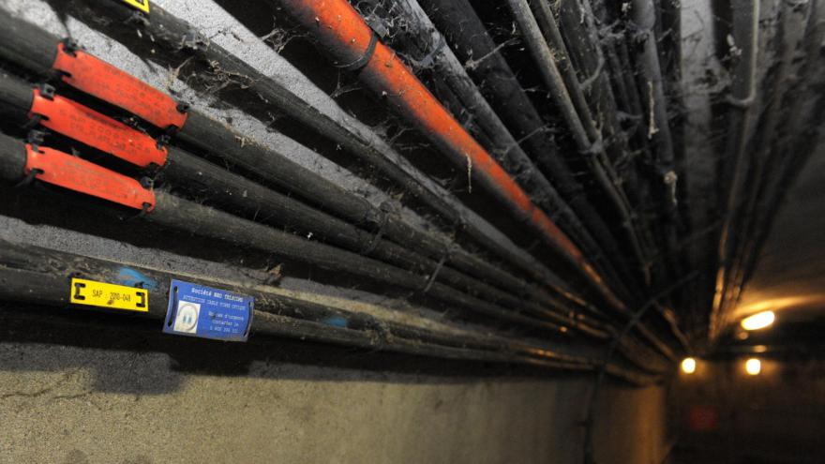
Cables to embed and protect fibres
Typical cable values
Number of fibres embedded
1 (of few) fibres for jumper cables
24-48 fo for
collecting traffic in networks
Submarine cables
72/96 for transportation
144/288 for long haul terrestrial networks / Core networks
1152++ for specific requirements (for instance between datacenters)
Environmental constraints
Cables can also embed specific requirements
LSOH to reduce gaz emission in case of fire
Increased protection to torsion/bending (however brings a constraint to deployment)
Specific resistance to animals for instance rats in sewers
Cables are challenged in datacenters and other sites as people are walking on them…

Slide 23
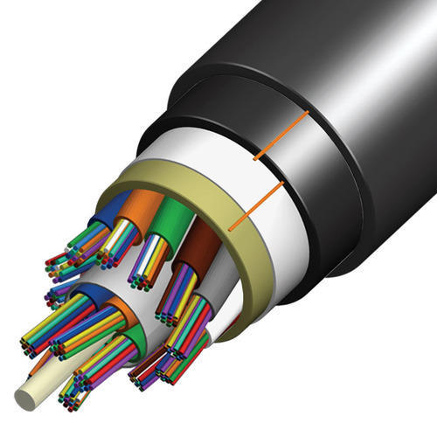
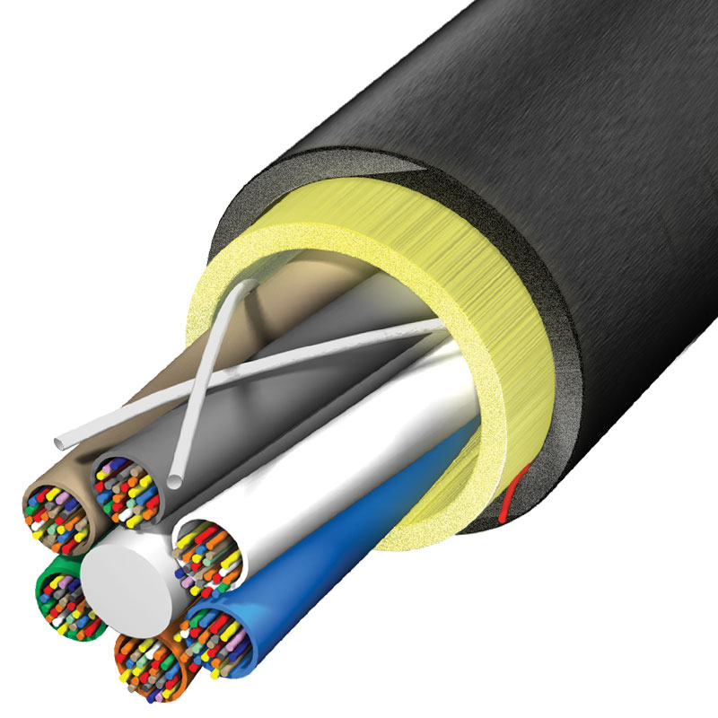
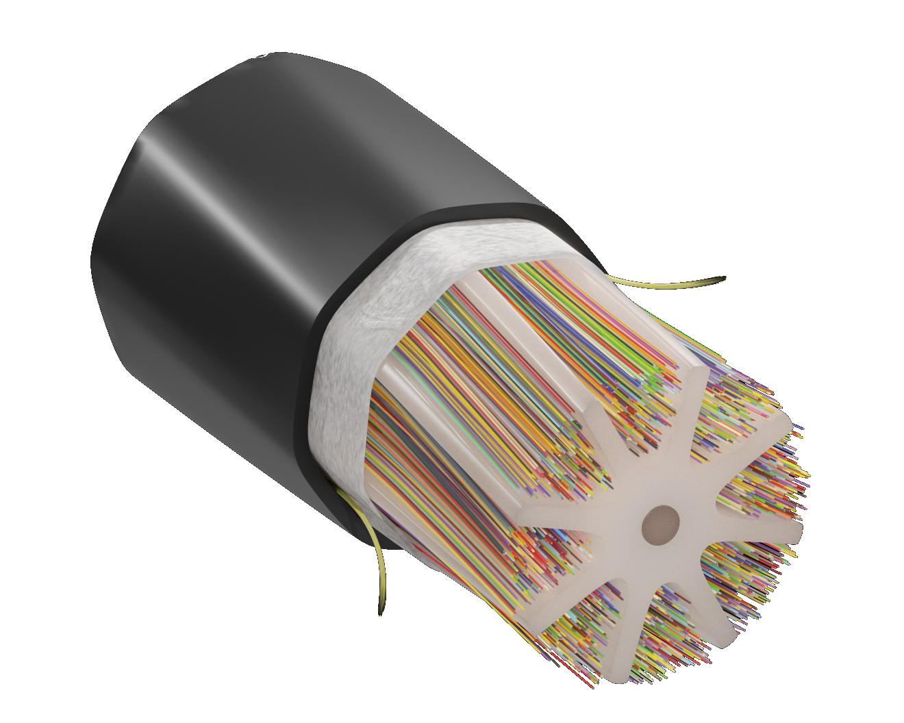
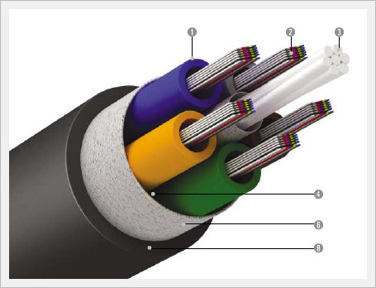
Optical fibre, cable technology
Cable with Tubes
Fibres are gathered in tubes
Loose tubes
Micro tubes
Cables with ribbons
A technology aiming at making easy the connexion of high number of fibres in the same cable

Slide 24
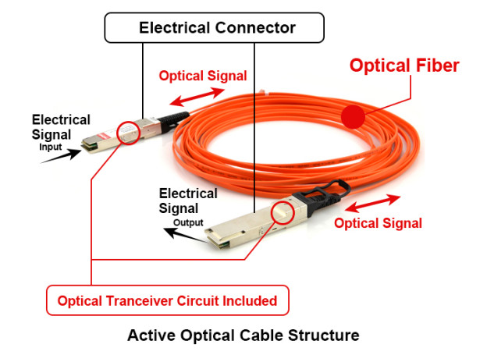
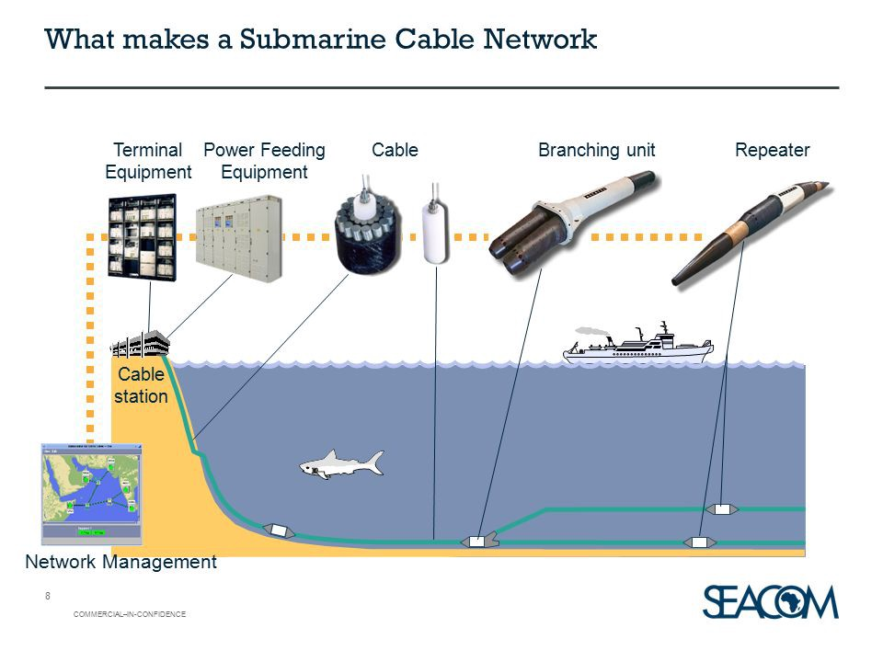
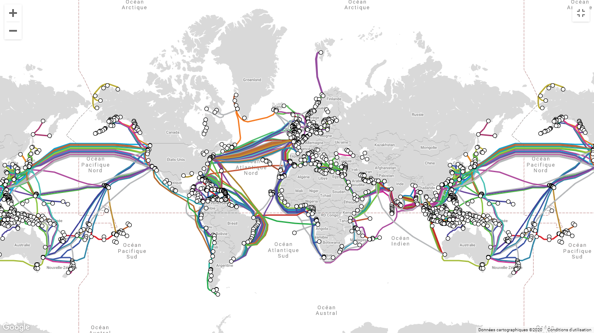
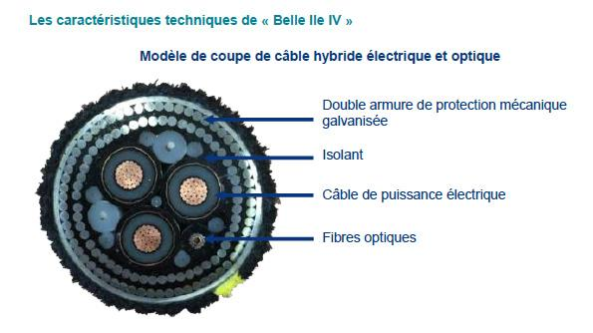
Cables that brings power
Active Cables … special needs
To address the need for bringing at the same time communication and power, a typical need for
Very long haul connection (intercontinental)
Submarine cables
Some application also for office building to bring power and telecom facility everywhere in the same cable. Low constraint with electromagnetic fields compared to coaxial cable.

Slide 25
Optical Fibre Accessories around

Slide 26
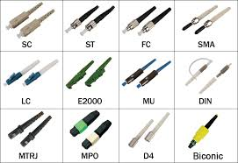
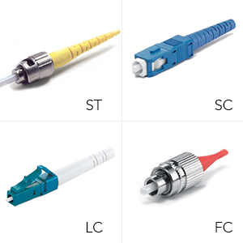
Connectors
Why a (physical) connector ?
Aligning or coupling fibre
High precision for the light to get through completely
Reduce as much as possible loss of energy
Easy connection/deconnection in an equipement
Characteristics
Minimum loss (usually around 0,4 dB)
Reliability and resistance to environmental conditions
Easy manipulation for connecting devices/equipments
The most widely used connectors in the area:
SC (Subscriber Connector), very common
LC (Lucent Connector), smaller that SC
FC (Ferrule Connector), used for monomode jumpers, currently replaced by SC connectors
ST (Straight Tip), used for multimode jumpers, highly résistent to too strong tightening

Slide 27
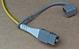
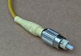
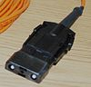
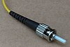
Connector history (1/4)
 | Nom long | Norme | Type | Remarque | Illustration
DIN LSA |  | CEI 61754-3 |  | Obsolète
EC | European Connector | CEI 1754-8 |  | Telecom
FC | Fiber-Ferrule Connector | CEI 61754-13 |  | Telecom
ESCON |  |  |  | Mainframe IBM et compatible
ST | Straight Tip | CEI 61754-2 | Baïonnette | Développé par AT&T

Slide 28
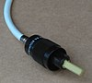
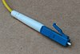
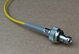
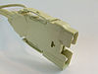

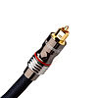
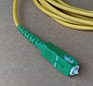
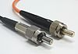
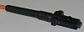
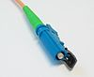
Connector history (2/4)
 | Nom long | Norme | Type | Remarque | Illustration
LX5 |  | CEI 61754-23 |  | Rarement utilisé
LC | Lucent Connector³ | CEI 61754-20 | Snap
MIC | Media Interface Connector (FDDI)
MU |  | CEI 61754-6 |  | Utilisé au Japon
OptoClip2 |  | IEC(86B)CFO 10 | Push-pull
SC | Switching Connector | CEI 61754-4 |  | Standard/Subscriber/Square Connector (Très utilisé)
MTRJ | Media Termination - Recommended Jack³ | CEI 61754-18

Slide 29
Connector history (3/4)
 | Nom long | Norme | Type | Remarque | Illustration
SMA 905 |  |  |  | Lasers industriels
TOSLINK |  |  |  | Audio numérique
E-2000 |  | CEI 61754-15 | Snap | Telecom
MPO | Multi-fibre Push-On/Push Off | IEC-61754-7; EIA/TIA-604-5 (FOCIS 5) | Snap (couplage multiple push-pull) | Intègre 12 (version la plus courante) ou 24 brins optiques.
VFO | Verranne Fibre Optique |  | Vissé | Maximum 2.5GBits/s.
Souriau | Souriau 8016 10A 003 |  | Vissé | Multimode. Obsolète. Date des premiers réseaux optiques en France pour la transmission PDH (TNLO 34MBit/s).

Slide 30
Connector history (4/4)
 | Nom long | Norme | Type | Remarque | Illustration
VFO | Verranne Fibre Optique |  | Vissé | Maximum 2.5GBits/s.
Souriau | Souriau 8016 10A 003 |  | Vissé | Multimode. Obsolète. Date des premiers réseaux optiques en France pour la transmission PDH (TNLO 34MBit/s).

Slide 31


Connector structure
Fibre cut
PC – Physical Contact (allow a very low return loss)
UPC – Ultra PC (even lower return loss)
APC – Angle PC (the lowest return loss solution, up to 60 dB)
Depending on the need, conectors can either be mono-fibre or bifibre.

Slide 32








SFP
Small Form-Factor Pluggable
This is the optical module that
Emits the signal on the fibre
Receives the signal on the other end
Adapts electric signal to light signal, specific to wavelength
Includes LED/Laser beam
Different types of SFP according to use
SFP / SFP+ for various rates (up to 25 Gbps currently)
Single or bi-fibre adapteur

Slide 33




Jumpers
Single fibre cables (occasionnaly Bi-Fibre)
Used for connection between equipement in a rack (also used at home between wall adapter and internet box)
Allow to (re)map easily connections in datacenters for instance
SC connector
LC connector

Slide 34


Breakouts and half breakouts
Variation on Jumpers
Allow connection between equipment requiring a set of fibres (typically radio site with multiple sectors)
Preventing a mess of jumpers between equipments, especially with equipements are not close the one to the others
Embed connectors, thus imply loss

Slide 35
Installing optical fibre

Slide 36


Manholes
Developed infrastructure
Typically in France GCBLO infra but also other existing partners (Axione…)
A contract with rules to access the infra
Number of equipments
Number of cables
Access and maintenance
Some rules for developping infra, especially in dense area depending on cities
Multiple format/size
L1T/L2T/L3T
Characteristics, mainly the size and access to ducts
Interconnection between infra

Slide 37


Splicing optical fibre
A key for network extension and connections
Soldering to fibres to offer continuity
Touchy operation
Aligning the core to avoid refraction/reflection
Case of G657 and G652
A sensitive operation
An operator usually made outside
Sensitivity to dust
Sensitivity to humity
…that can lead to signal attenuation
Targeted attenuation is less that 0,1 dB (usually a challenge)

Slide 38

Street cabinet
Capability of such cabinets
Possibility to share space between operators
Easy access to mapping capability
Risks of easy access
Multiple actors from various companies Sometime keys are used… and broken Real difficulty to trace accesses
Malicious operations, however not that much
Typical use
FTTH
Other networks special cases

Slide 39




Ducts for telecom cables
Existing networks
Several operators have a duct infrastructure
Orange has to provide access
Other existing offers (Axione, Covage, …)
Constraints in some areas from regulation

Slide 40

Digging for optical fibre networks
Urban areas
Existing networks present and prefered when not saturated see previous slides
Suburban and countryside
Long haul trenches, micro trench made by machines
Rules
Depth
Size/Number for ducts normalized
Soil to fill holes
Access to manholes and equipment

Slide 41

Alternative to ducts : aerial net (1)
Already developed network
Existing networks available for development, for instance in France
Orange
Enedis
Constraints
Type of fibre cables due to resistance between poles
Some perturbation with vibrations due to wind
Limitation (weigth and cable capacity) to usually less than 72fo
Risk of the infrastructure
Weather condition (storms…)
Malicious acts
… but much cheaper than digging for ducts, especially

Slide 42


Alternative to ducts : aerial net (2)
Network from Power Providers
Existing networks over high voltage lines
Available for long haul
Constraints on the places to get in/out the line
Limited to pole places
Usually tied to the power provider network
Technologies
Usually along with a structure cable
In some case, embeded in the power cable (not usual)
Due to the structure of the poles, this network is considered as secure as ducts

